Slide 1
Pens and Printers
Product Sales Strategy Analysis

Slide 2
Introduction to Pens and Printers Project
Project Overview
Established in 1984, Pens and Printers is a provider of premium office products to large organizations.
Evolving consumer buying behavior necessitated the introduction of three distinct sales methods: Email, Call, and Email + Call.
Essential insights are to be reported to the executive team within four weeks.
Project Objectives
To inform and optimize sales strategies for the newly launched office stationery line.
The Specific goals include understanding:
customer distribution by sales approach,
investigating revenue spread,
exploring revenue trends over time,
recommending the most effective sales method, and
uncovering potential differences between customer groups.

Slide 3
Summary of the work done and relevance to the business problem
The challenges are to understand customer distribution, revenue patterns, recommend effective sales methods, and identify customer group differences.
Identification of customer distribution across sales methods revealing a heterogeneous market and its importance to understanding and meeting customer preferences.
Identification of revenue distribution and patterns across sales methods showing clusters of revenue values and sales methods revenue trends over time. It is key for utilizing different sales strategies for better alignment with customer behavior.
Identification of sales method that balances high revenue and strong conversion rates. It is offering a strategic direction for maximizing revenue and conversion rates based on sales team input.
Identification of customer group differences as being essential for crafting personalized strategies and optimizing engagement.

Slide 4
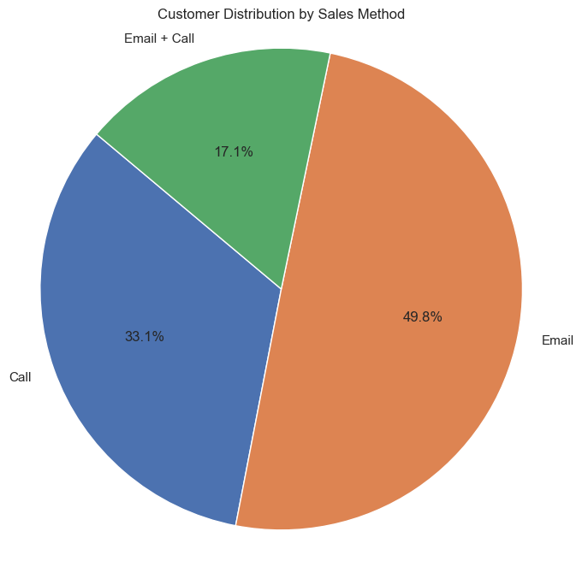
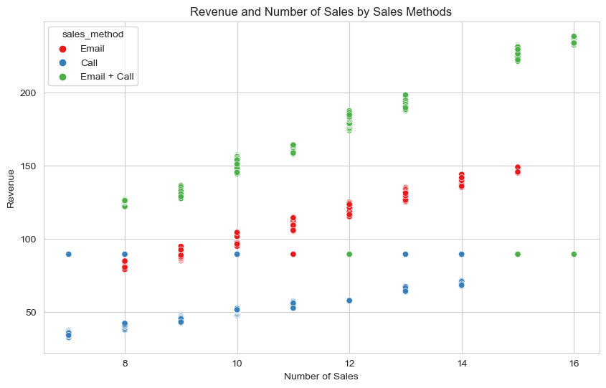
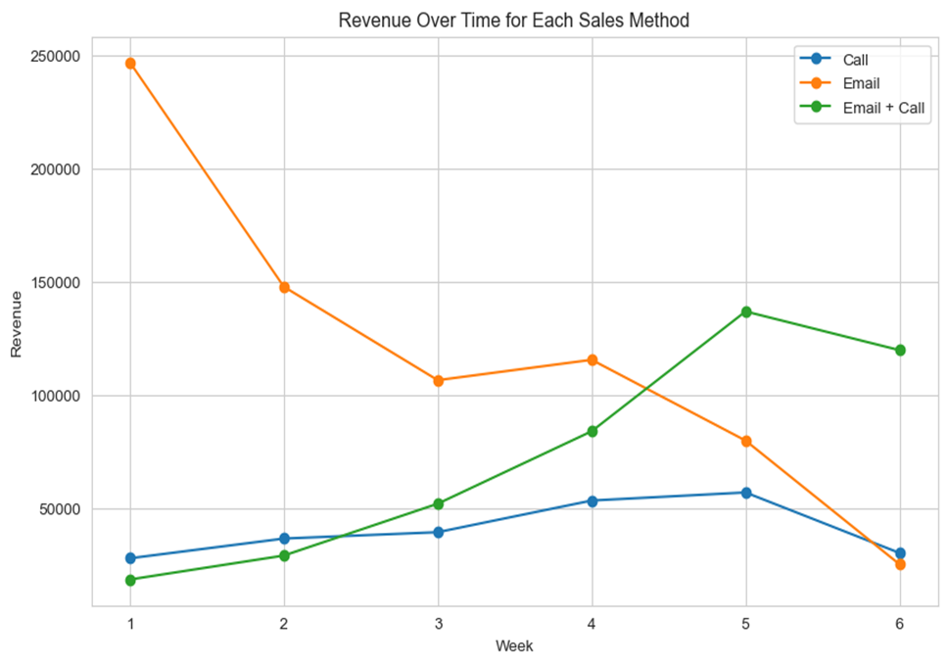

Slide 5
Key Findings
Business Metrics to Monitor
Customer Distribution: Email (49.77%), Call (33.08%), and Email + Call (17.15%).
Revenue Patterns Over Time: Email leads initially, Email + Call surges later, Call maintains consistency.
Most Effective Sales Method: Email + Call: High total and average revenue, strong conversion rates, efficient site visits.
Efficiency Metrics: Email + Call Method: Exceptional performance with $6.38 revenue per site visit.
Geographic Insights: Varied customer distribution across states, suggesting state-specific marketing strategies for diverse market dynamics.
Customer Lifetime Value (CLV): Continuous monitoring for strategic decision-making and identifying high-value customers for optimized sales.
Customer Retention Rate: Monitors rates to enhance satisfaction and loyalty, it is crucial for achieving long-term business success.
Average Customer Tenure: indicates sustained loyalty and satisfaction.
Current Metrics Estimation
CLV estimated at $110,743.03 based on current data.
Customer Retention Rate is estimated at 90.19% based on current data.
Mean Customer tenure of 4.97 years based on current data.

Slide 6
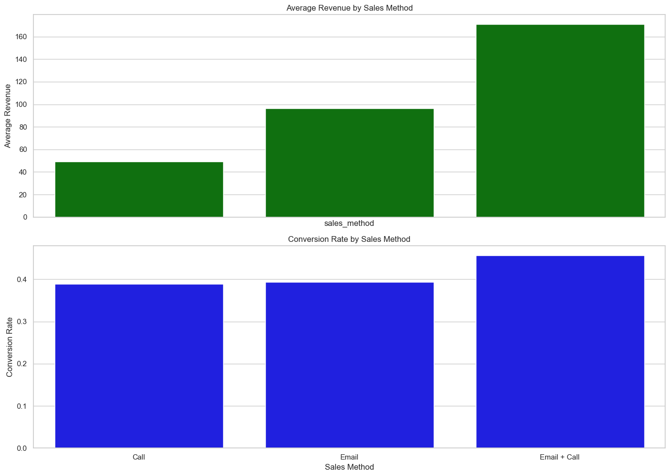
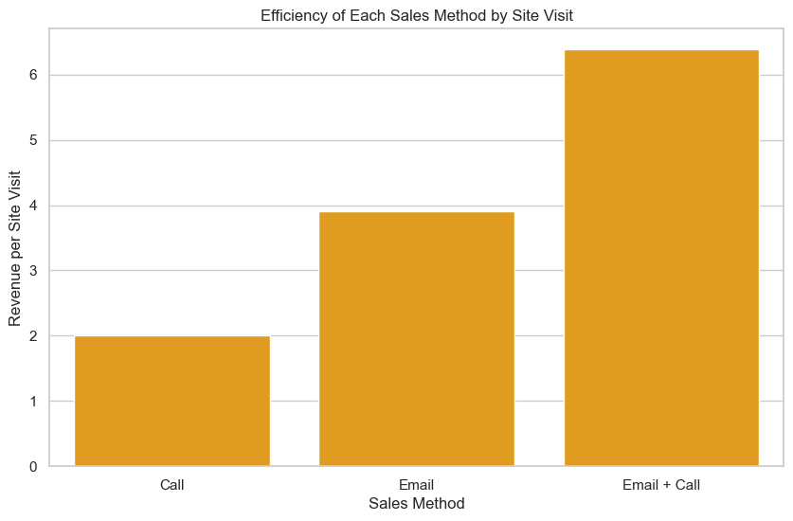

Slide 7
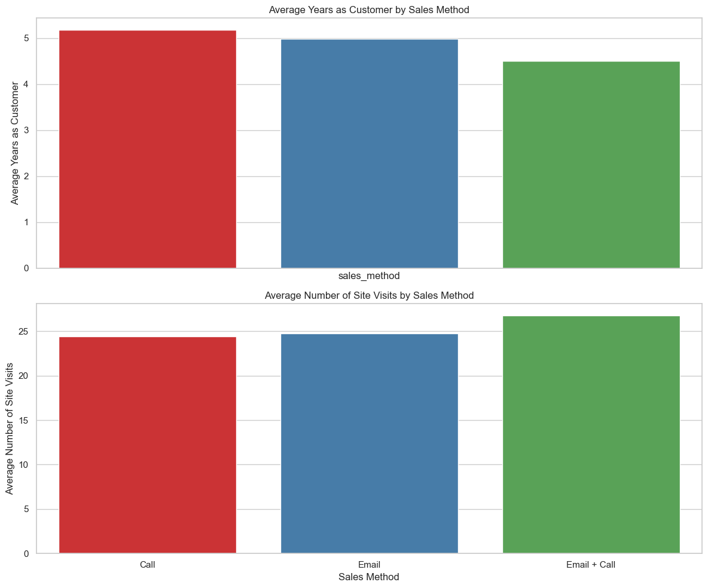
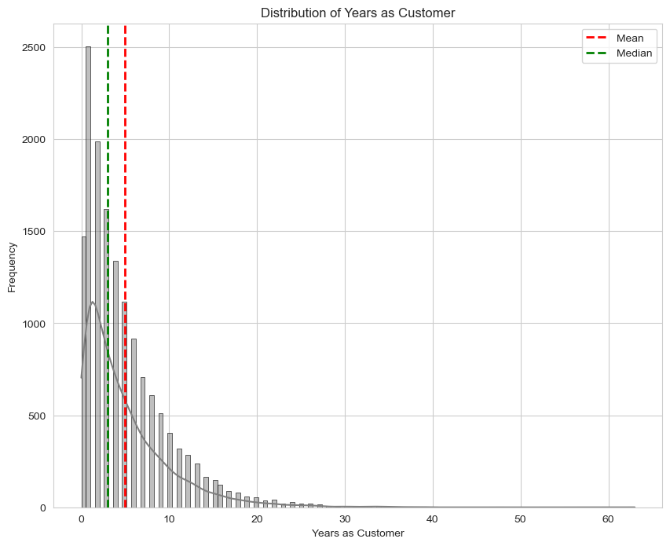

Slide 8
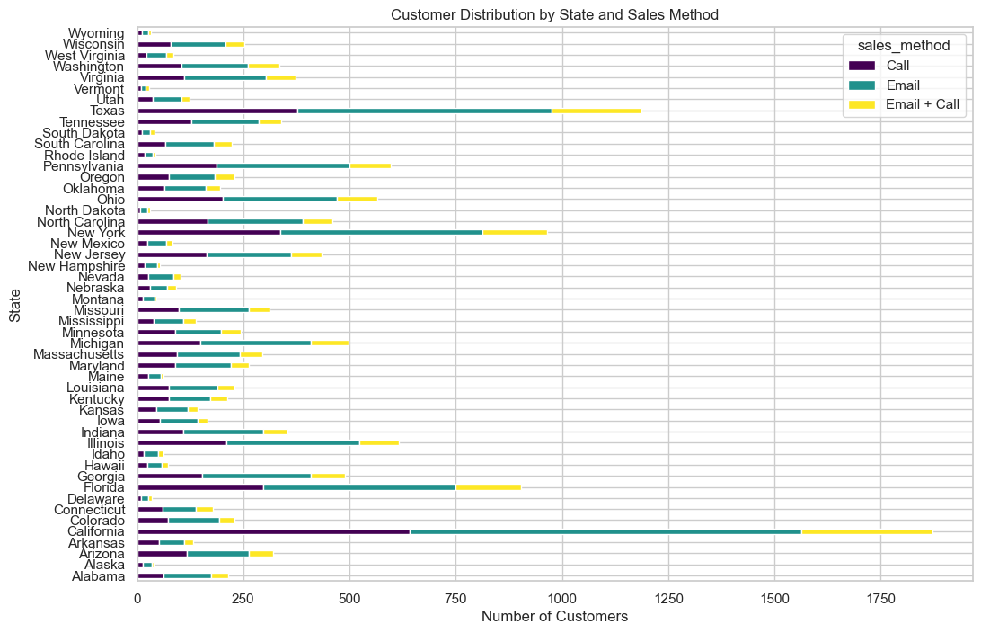

Slide 9
Recommendations for Pens and Printers
Continuous CLV Monitoring: Systematic monitoring and baseline formation across customer segments using historical data.
Sales Method Optimization: Prioritize high-performing methods and adopt customer-centric approaches.
Enhancing Engagement: Implement personalized promotions and loyalty programs through active social media engagement.
Investigating Areas: research on customer segmentation, marketing channels, product performance and measure customer satisfaction.
State-Specific Marketing: Implement marketing strategies based on regional preferences in states with higher customer concentrations.
Employee Training: Invest in training for a customer-centric approach and align team incentives with CLV metrics.
Strategy Review: Periodic review of CLV and revenue trends and adjust strategies based on evolving CLV.
Benchmarking: Compare CLV against industry standards and Identify areas for improvement compared to benchmarks.
Scaling Success: Scale successful methods based on performance and Enhance underperforming methods.

Slide 10
THANK YOU

